Slide 1
SUS Performance Funding
Institute for Academic Leadership
Joe Glover
October 2016

Slide 2
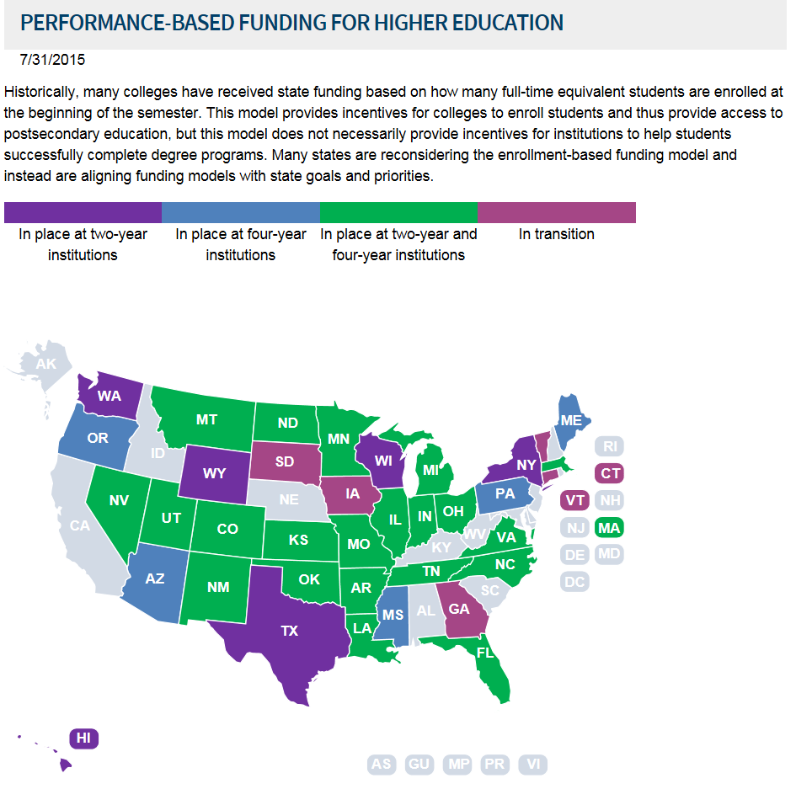

Slide 3
The Performance Funding Model includes 10 metrics that evaluate the institutions on a range of issues. Two of the 10 metrics are Choice metrics; one picked by the Board of Governors and one by the university boards of trustees. These metrics were chosen after reviewing over 40 metrics identified in the University Work Plans.
The model has four guiding principles: 1) use metrics that align with SUS Strategic Plan goals, 2) reward Excellence or Improvement, 3) have a few clear, simple metrics, and 4) acknowledge the unique mission of the different institutions.
Key components of the model:
Institutions will be evaluated on either Excellence or Improvement for each metric.
Data is based on one-year data.
The benchmarks for Excellence were based on the Board of Governors 2025 System Strategic Plan goals and analysis of relevant data trends, whereas the benchmarks for Improvement were determined after reviewing data trends for each metric.
The Florida Legislature and Governor determine the amount of new state funding and a proportional amount of institutional funding that would come from each university’s recurring state base appropriation.

Slide 4
Metrics Common to all Institutions:
Seven metrics apply to all eleven institutions. The eighth metric, graduate degrees awarded in areas of strategic emphasis (8a), applies to all institutions except New College. The alternative metric for New College (8b) is “freshman in the top 10% of graduating high school class.”

Slide 5
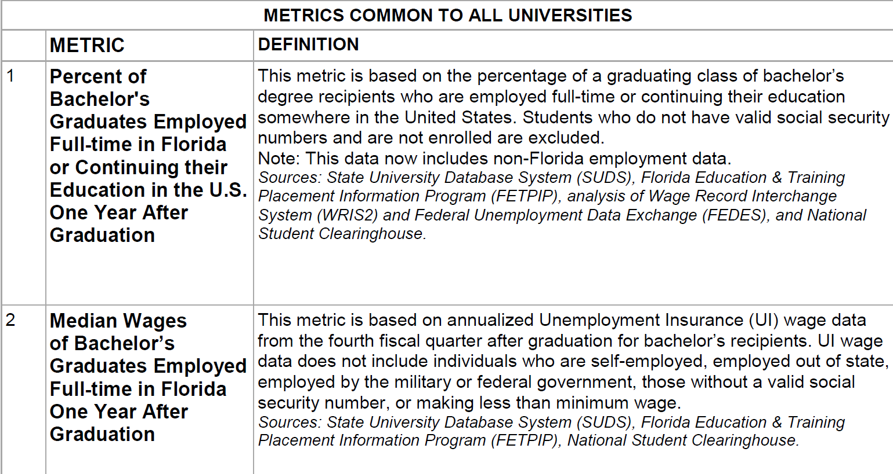

Slide 6
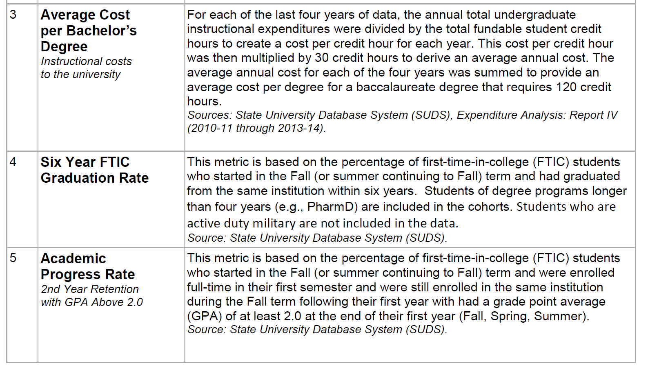

Slide 7
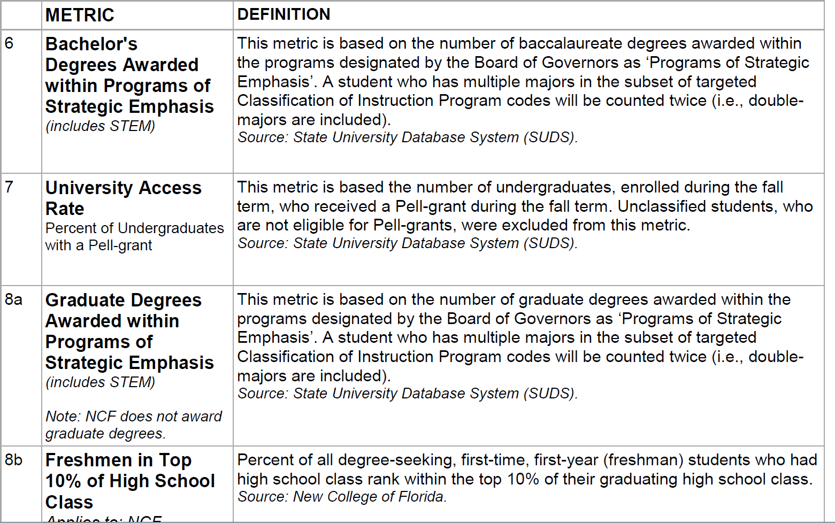

Slide 8
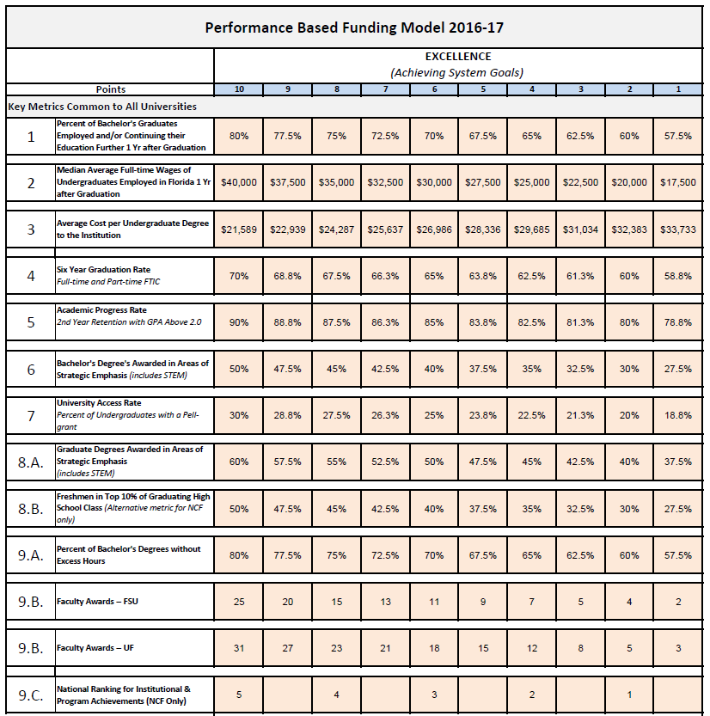

Slide 10
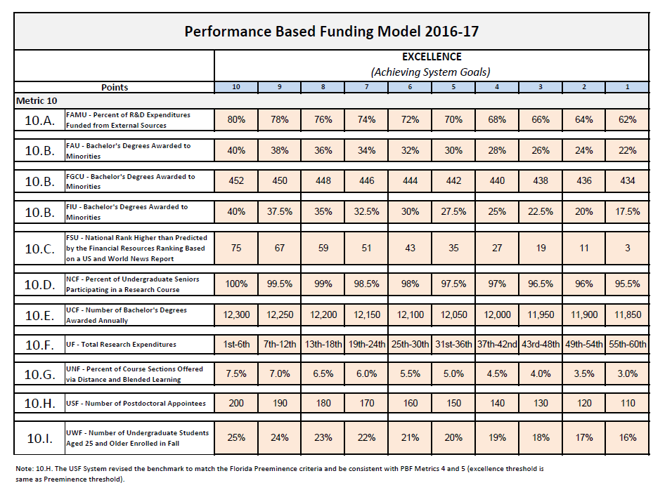

Slide 11
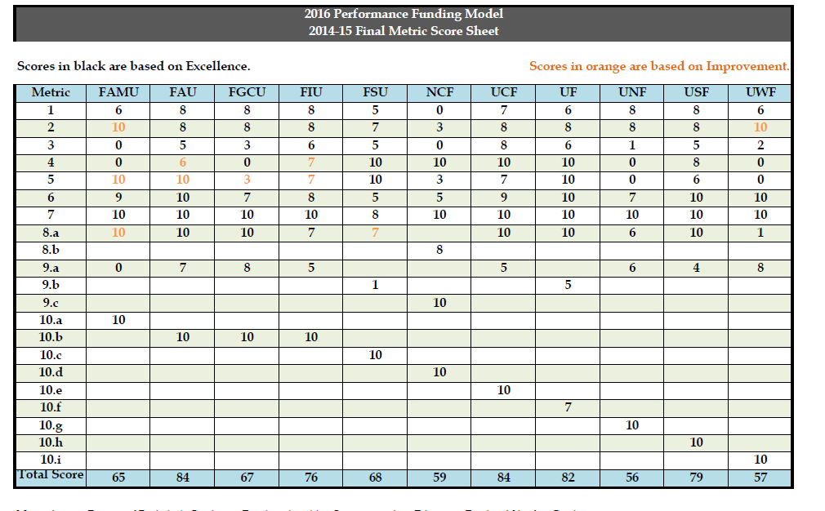

Slide 12

How will the funding component of the model work?
To ensure each university is striving to excel and improve on key metrics, there must be a financial incentive. That financial incentive will not only be new state funding, but an equal reallocation of a portion of the base state funding.

Slide 13
New Funding versus Base Funding:
The amount of new state funding appropriated by the Legislature and Governor for performance funding will be matched by an equal amount reallocated from the university system base budget. These “base” funds are the cumulative recurring state appropriations the Legislature has appropriated to each institution. Any new funding appropriated would be allocated as follows:
State New Funding Allocation
Each university metric is evaluated based on Excellence or Improvement and has five benchmarks ranging from low to high. The lowest benchmark receives one point, while the highest receives five points. The highest points for Excellence or Improvement are counted in the university’s total score.
New funding will be allocated based on points earned, with a maximum of 50 points possible.
A university must earn more than 25 points in order to be eligible to receive new funds.
A university scoring 25 points or less or the three lowest scoring universities would not receive any new funds.
A university earning more than 25 points would receive new funds proportional to their existing base funds with the highest scoring universities eligible for additional new funds.
The Board’s practice is to address all ties to the benefit, not the detriment, of the institutions in question. No matter where the tie takes place in the score rankings, the practice is the same.

Slide 14

Institutional Base Funding Allocation
A prorated amount would be deducted from each university’s base recurring state appropriation.
A university earning more than 50 points will have their base funding restored.
A university scoring 50 points or less will have to submit an improvement plan to the Board of Governors and show improvement according to that approved plan in order to have their base funding restored.

Slide 15

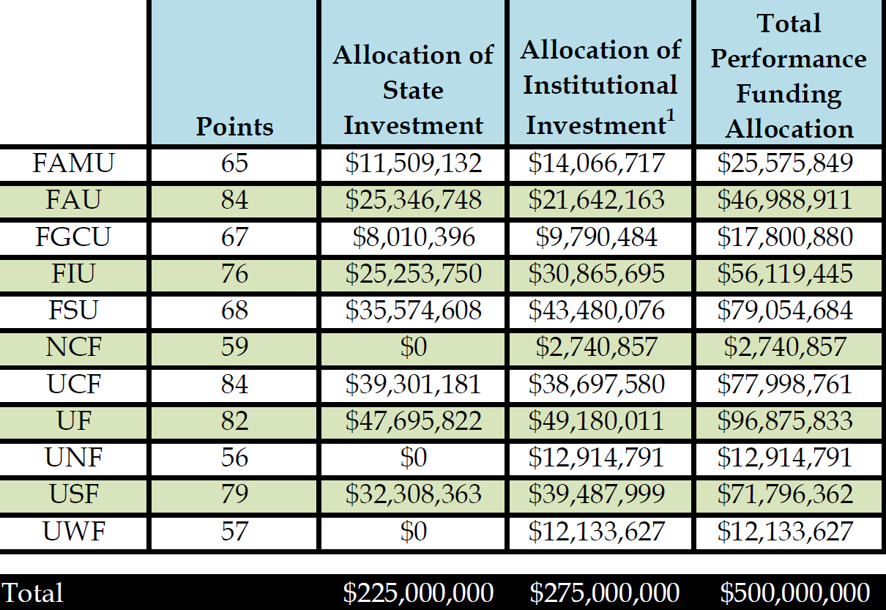

Slide 16

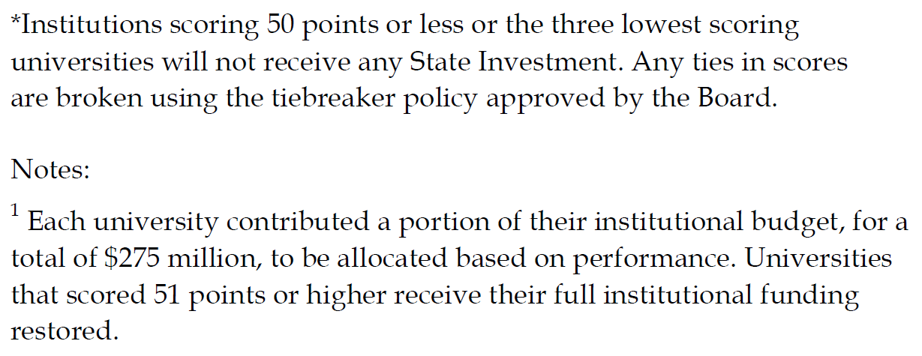

Slide 18
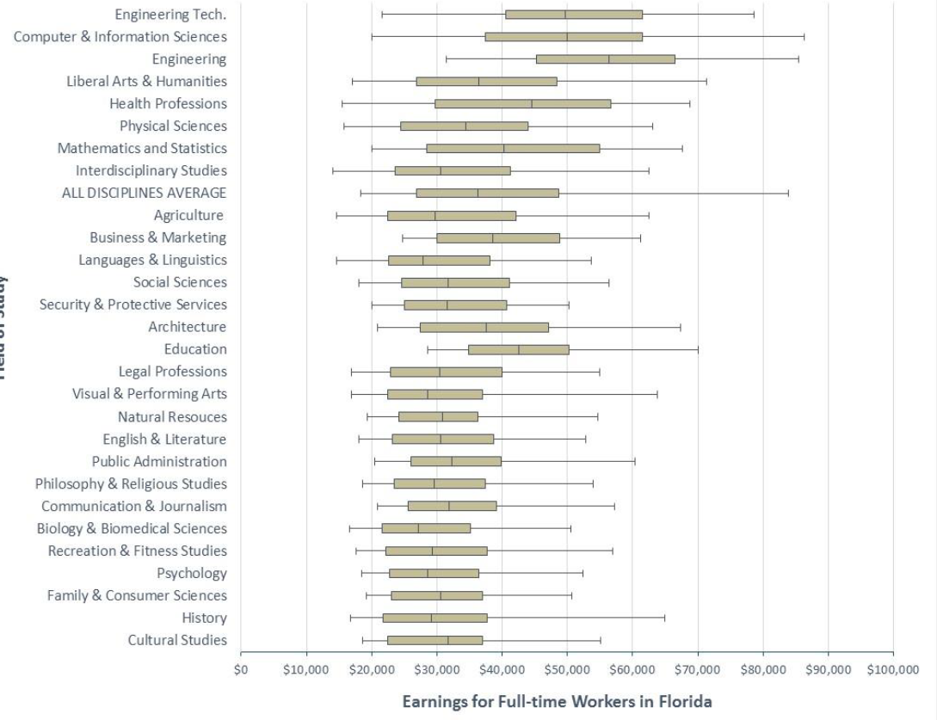

Slide 19
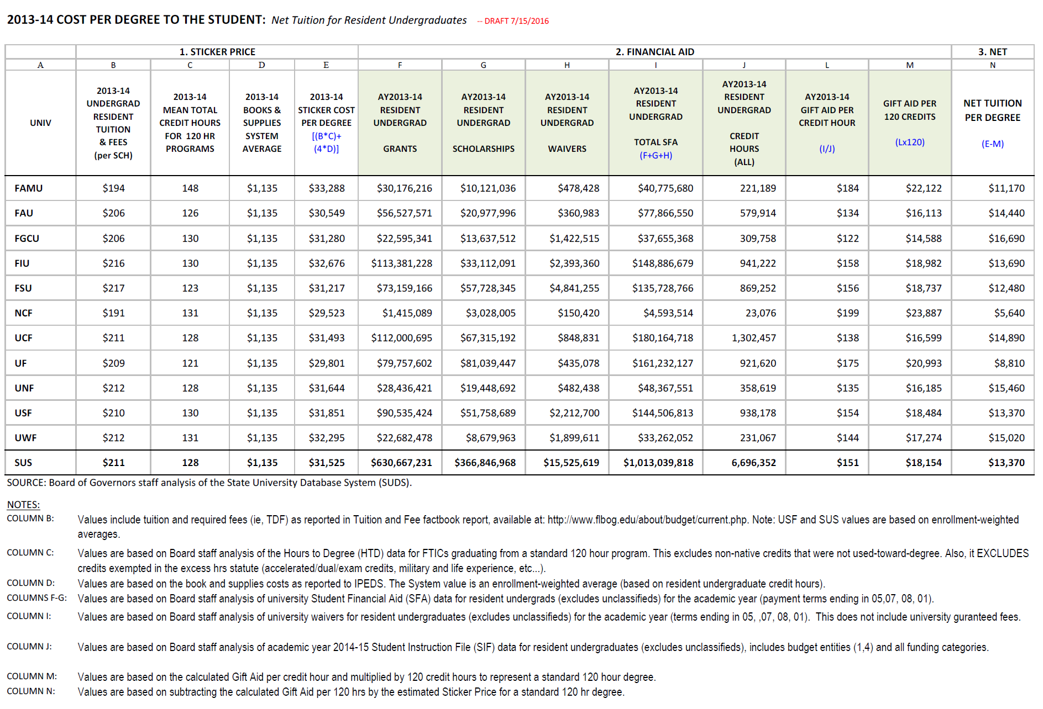

Slide 20
